Slide 1


How to host and deliver your training in a FAIR way
Module 3 – FAIR Training Material by Design
September 18-19, 2024
Nina Norgren

Slide 2
Learning outcomes
By the end of this session, you should be able to:
List common e-learning platforms
Explain what the SCORM format is
Describe pros and cons of different Learning Management Systems, from a FAIR perspective
Create a course page setup to host and deliver training
Describe how to make your training material FAIR using only google drive

Slide 3


What do we mean by hosting and delivery?
Hosting of materials:
G suite / Nextcloud
Github
Zenodo / Figshare
Delivery:
LMS
Github pages
Image by svstudioart on Freepik
Image by jcomp on Freepik

Slide 4
The 4 phases of training materials life cycle
Development
Archiving
Delivery
Sharing

Slide 5
The 4 phases of training materials life cycle
G Suite / Nextcloud
Github
G suite / Nextcloud
Github
LMS
Zenodo / Figshare
Development
Archiving
G Suite / Nextcloud
Github
Delivery
LMS
Github pages
Sharing

Slide 6
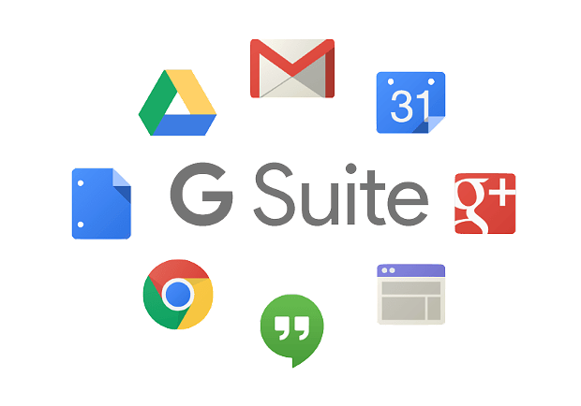

G Suite + LMS
Image by vectorjuice on Freepik
G Suite to develop the materials in a collaborative environment
An LMS to deliver, share, and archive the training

Slide 7
G Suite
Collection of tools from Google
Drive (for storing material)
Slides
Documents
Other data
Email (for communication with students)

Slide 8



G Suite (google drive) / Nextcloud
No global discovery (not indexed by search engines). Link required.
FINDABLE
Access control can be regulated (individual sharing, public access, read/write permissions)
ACCESSIBLE
Supports common file types for viewing and editing: PDFs, google docs, microsoft office files. Possible for several persons to work in same collaborative document.
INTEROPERABLE
Content can be duplicated, but only basic version control. Make sure to add README and other relevant information.
REUSABLE

Slide 9
Learning management systems (LMS)
What is a Learning management system (LMS)?
A platform to host and manage training materials, track student progress, and engage learners
Why use an LMS?
Centralized platform
Tracks learner progress and support learning
Image by vectorjuice on Freepik

Slide 10
Common LMSes
 | Pros | Cons
Moodle - open source | Customizable Large community Good for academic use | Requires technical expertise
OpenEDX - open source | Scalable Global use Supports rich content | Requires technical support
Canvas - subscription | User friendly Robust integrations Stable development | Expensive Limited customization
Google classroom - free/subscription | Easy setup Accessible | Limited customization and advanced features Costs extra for additional features

Slide 11
How an LMS makes your training FAIR
LMSes often include metadata, search features, and indexing for easy retrieval.
FINDABLE
LMSes manage access controls, supporting open and restricted access as needed.
ACCESSIBLE
SCORM (Sharable Content Object Reference Model) enables interoperability across different platforms.
INTEROPERABLE
Courses can be easily repurposed or adapted on most LMSes.
REUSABLE

Slide 12
Standards for e-learning content
SCORM (Sharable Content Object Reference Model)
is a technical standard for packaging training materials to ensure interoperability across different e-learning systems.
xAPI
is a modern standard that allows tracking of diverse learning experiences both inside and outside the LMS.
CMI5
CMI5 combines the flexibility of xAPI with the structure of SCORM. It is designed for traditional LMS use cases but also extends to more modern, flexible learning environments.

Slide 13
Standards for e-learning content
 | SCORM | xAPI | CMI5
Moodle | Yes | Yes | Yes
OpenEDX | Yes | Yes | Yes
Canvas | Upload | A small piece | No
Google classroom | No | No | No

Slide 14
G Suite + LMS
Develop course syllabus + LOs in google drive
Make presentations using google slides
Set up a LMS (for example OpenEDX)
Either download presentations as pdfs and upload to OpenEDX, OR, integrate them directly from google drive using iframes
Make sure to link to the google drive folder with all materials (making it read-only)

Slide 15
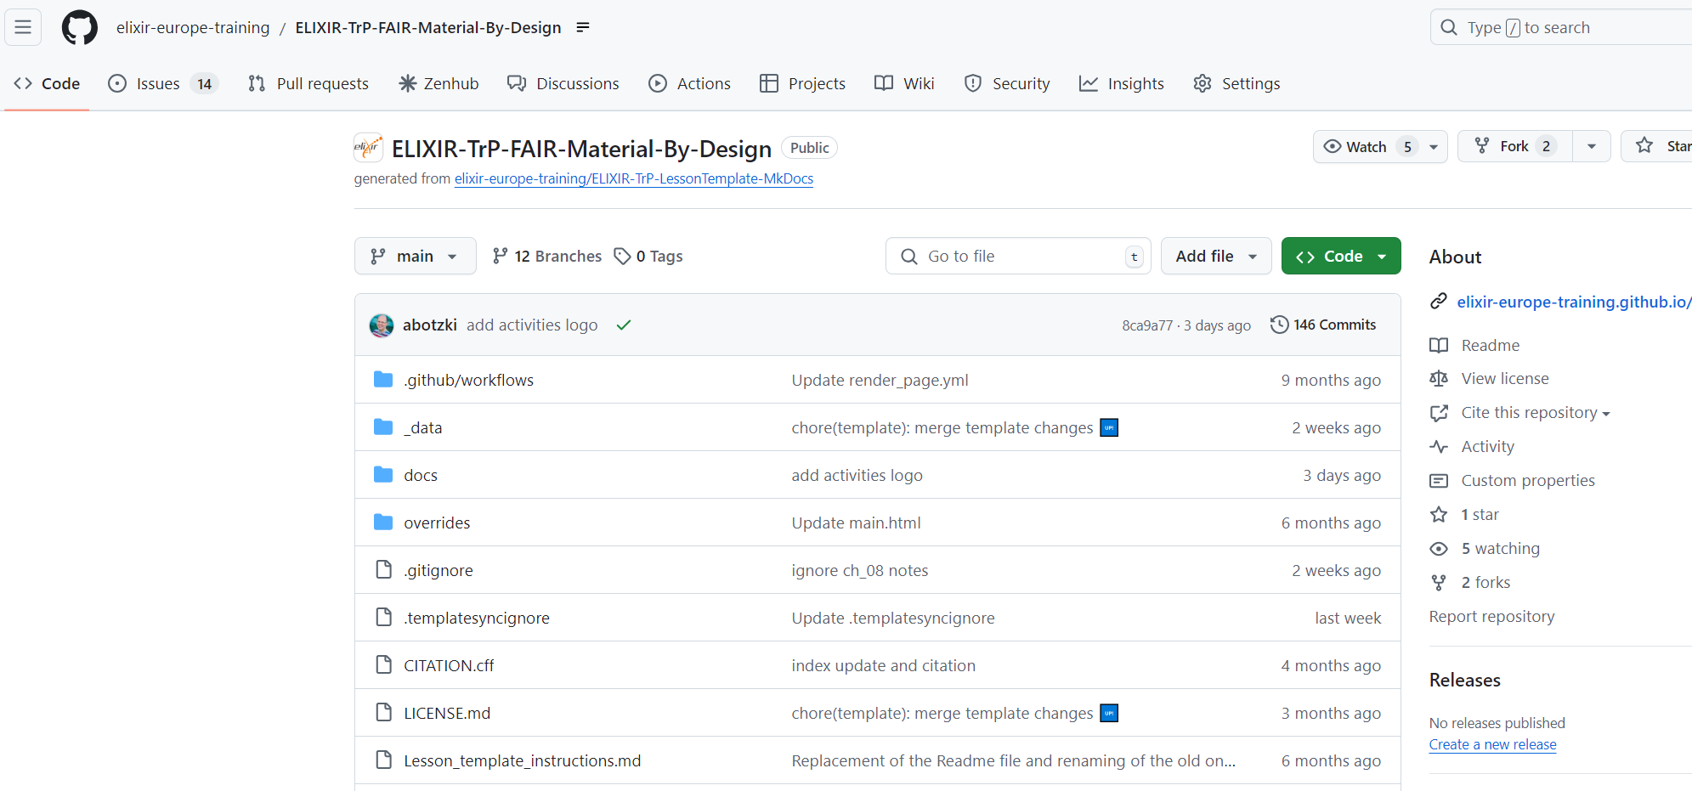
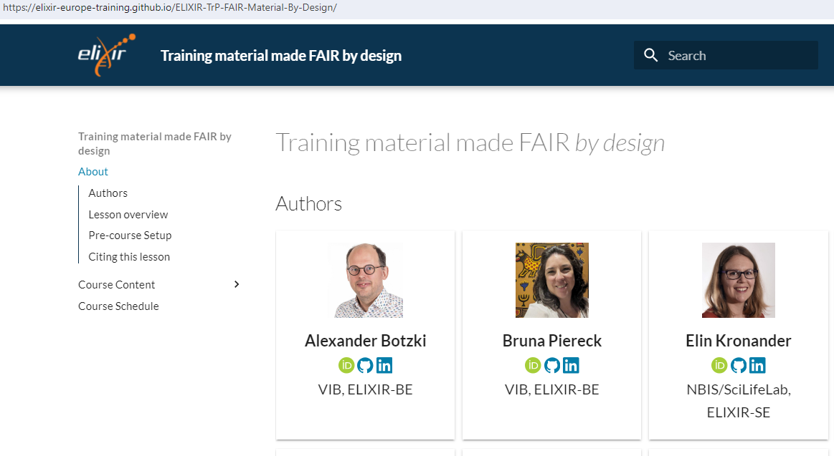
Github + github pages
Develop, share, archive content on github
Deliver and share it through github pages

Slide 16
Github + github pages
Indexed by search engines. Repositories can include detailed metadata.
FINDABLE
Repositories can be made public, providing open access, without giving away edit rights. Github pages allows access for everyone as a simple website.
ACCESSIBLE
Supports multiple file formats: markdown, html, notebooks, etc. Git allows for collaborations on the same repository, allowing several users to develop content.
INTEROPERABLE
Public repositories can be forked and reused as they are. Releases or branches can be made to keep several course instances up and running.
REUSABLE

Slide 17
Github + github pages
Create a github repository
Collaborate and create training materials in for example markdown
Use a framework for creating course page layout
mkDocs
Quarto
Liascript
Set up a github page from your repo (not needed with Liascript)
Share the link to the website with your students

Slide 18
Other combinations
Google drive + LMS
Github + Github pages
Google drive + Github pages
Github + LMS

Slide 19
Other combinations
Google drive + LMS
Github + Github pages
Google drive + Github pages
Set up a simple github page with basic structure of course and syllabus
Display course presentations, slides, videos on page, but hosted on google drive
Github + LMS
Develop all your course material on github
Use iframes or other renderers to display content in LMS

Slide 20
Discussion
 | Findable | Accessible | Interoperable | Reusable
Google drive | No, not searchable
Github + github pages |  | Yes, can be made public and accessible to all
LMSes |  |  |  | Exported in SCORM format

Slide 21
RNAseq analysis course - case study
Kate has an onsite course in RNAseq analysis. She sends out all relevant course information by email to the students. During the course she has prepared powerpoint slides for her presentations, and exercise instructions that she has in a google drive folder she shares with her students. After the course is done, she sends the slides as pdfs to her students.
Findable | Not findable.
Accessible | Only for student on email list
Interoperable | No licence, not reusable
Reusable | Only pdfs.

Slide 22
Microscopy course - case study
Steve has a course in microscopy, delivered online. He also has a google drive folder where he prepares all his slides, exercises, and other relevant information regarding the course. This folder is read-only for anyone with the link. He sets up a course website in Canvas, where he links all information from his google drive, including presentation slides and exercises. The course website he makes public so everyone can see it. Plus, he links to the original google drive folder from Canvas.
Findable | Not findable, indexed
Accessible | Everyone can see the content. Access to google drive
Interoperable | Google is. No scorm format
Reusable | No licence, so maybe not

Slide 23
R course - case study
Jane has a hybrid course in R. She has set up a course website using github pages and Quarto. She has a github repo where she creates all information regarding the course, including slides and exercises using markdown. She uses releases to separate different instances of her course. All relevant information is published on the github page, with the links to the github repo.
Findable
Accessible
Interoperable
Reusable

Slide 24
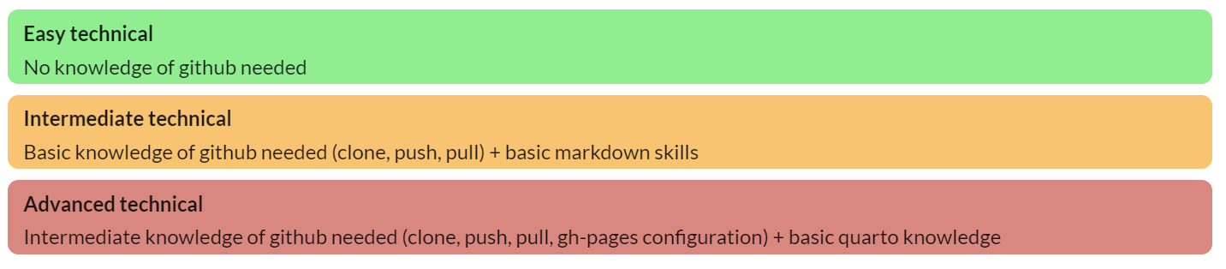
Exercise - set up your course website
Based on the syllabus and learning outcomes from the previous session
Easy: OpenEDX
Intermediate: github with Liascript
Advanced: github with github pages

